Slide 1


PINPOINT - HAT
“Putting illicit banking activities related to human rights violations & trafficking on the map.”

Slide 2
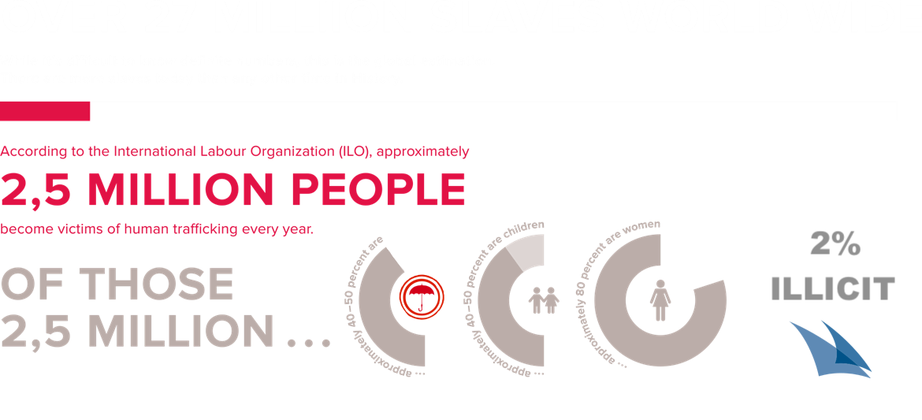
HUMAN TRAFFICKING AND RELATED ACCOUNTING TRANSACTIONS REPORTING
https://www.glowbalact.com/en/humantrafficking/, edited

Slide 3
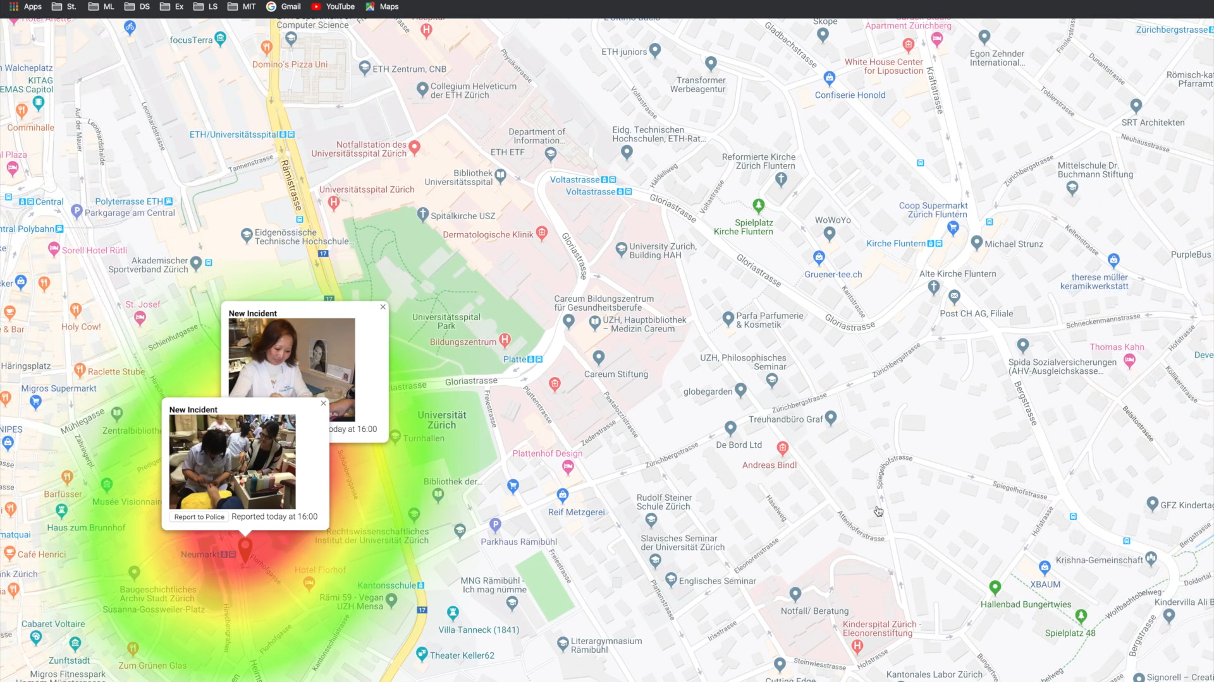
HUMAN TRAFFICKING AND RELATED ACCOUNTING TRANSACTIONS REPORTING

Slide 4






HAT - R
HUMAN TRAFFICKING AND RELATED ACCOUNTING TRANSACTIONS REPORTING

Slide 5
HAT - R
HUMAN TRAFFICKING AND RELATED ACCOUNTING TRANSACTIONS REPORTING
Support of HAT - Spots
Azure Bot Framework
Azure Computer Vision

Slide 6
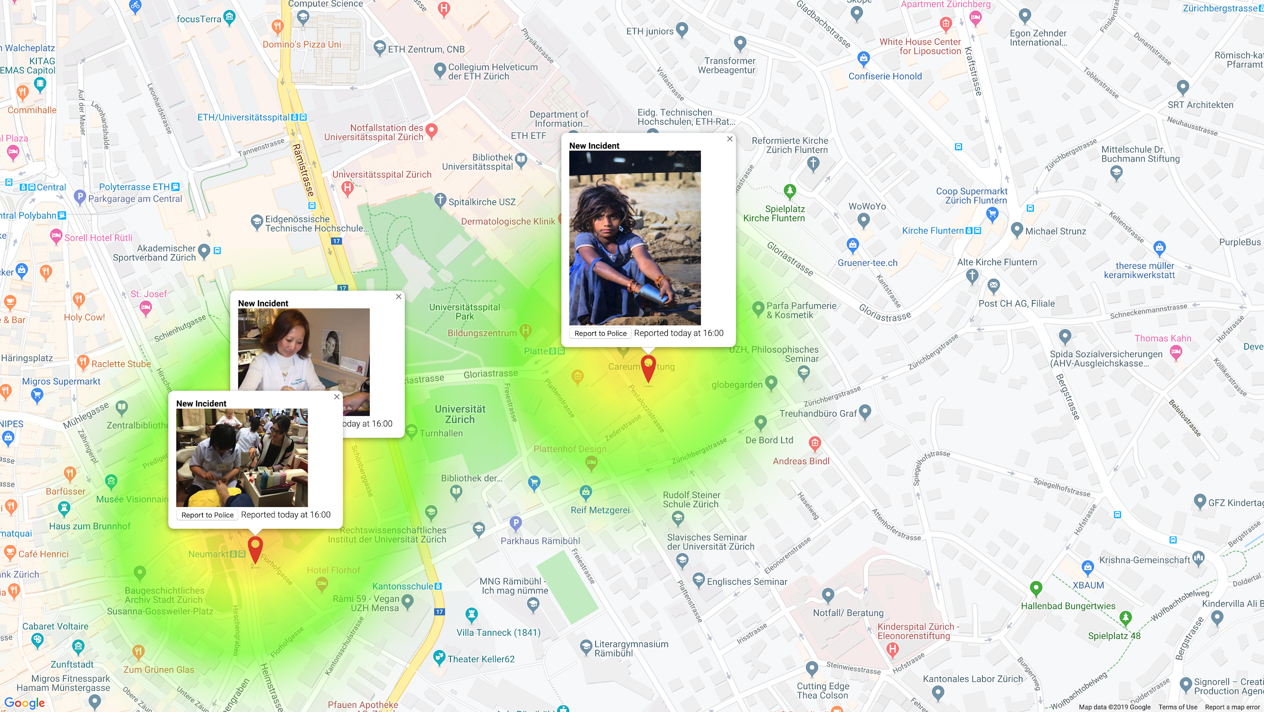
HUMAN TRAFFICKING AND RELATED ACCOUNTING TRANSACTIONS REPORTING

Slide 7
HAT - R
HUMAN TRAFFICKING AND RELATED ACCOUNTING TRANSACTIONS REPORTING
Support of HAT - Spots
Azure Bot Framework
Azure Computer Vision
Support of HAT - Spots
NLP Microsoft
Azure Cognitive Services
Google Maps API

Slide 8
HAT - R
HUMAN TRAFFICKING AND RELATED ACCOUNTING TRANSACTIONS REPORTING
Support of HAT - Spots
NLP Azure Cognitive Services
Google Maps API

Slide 9
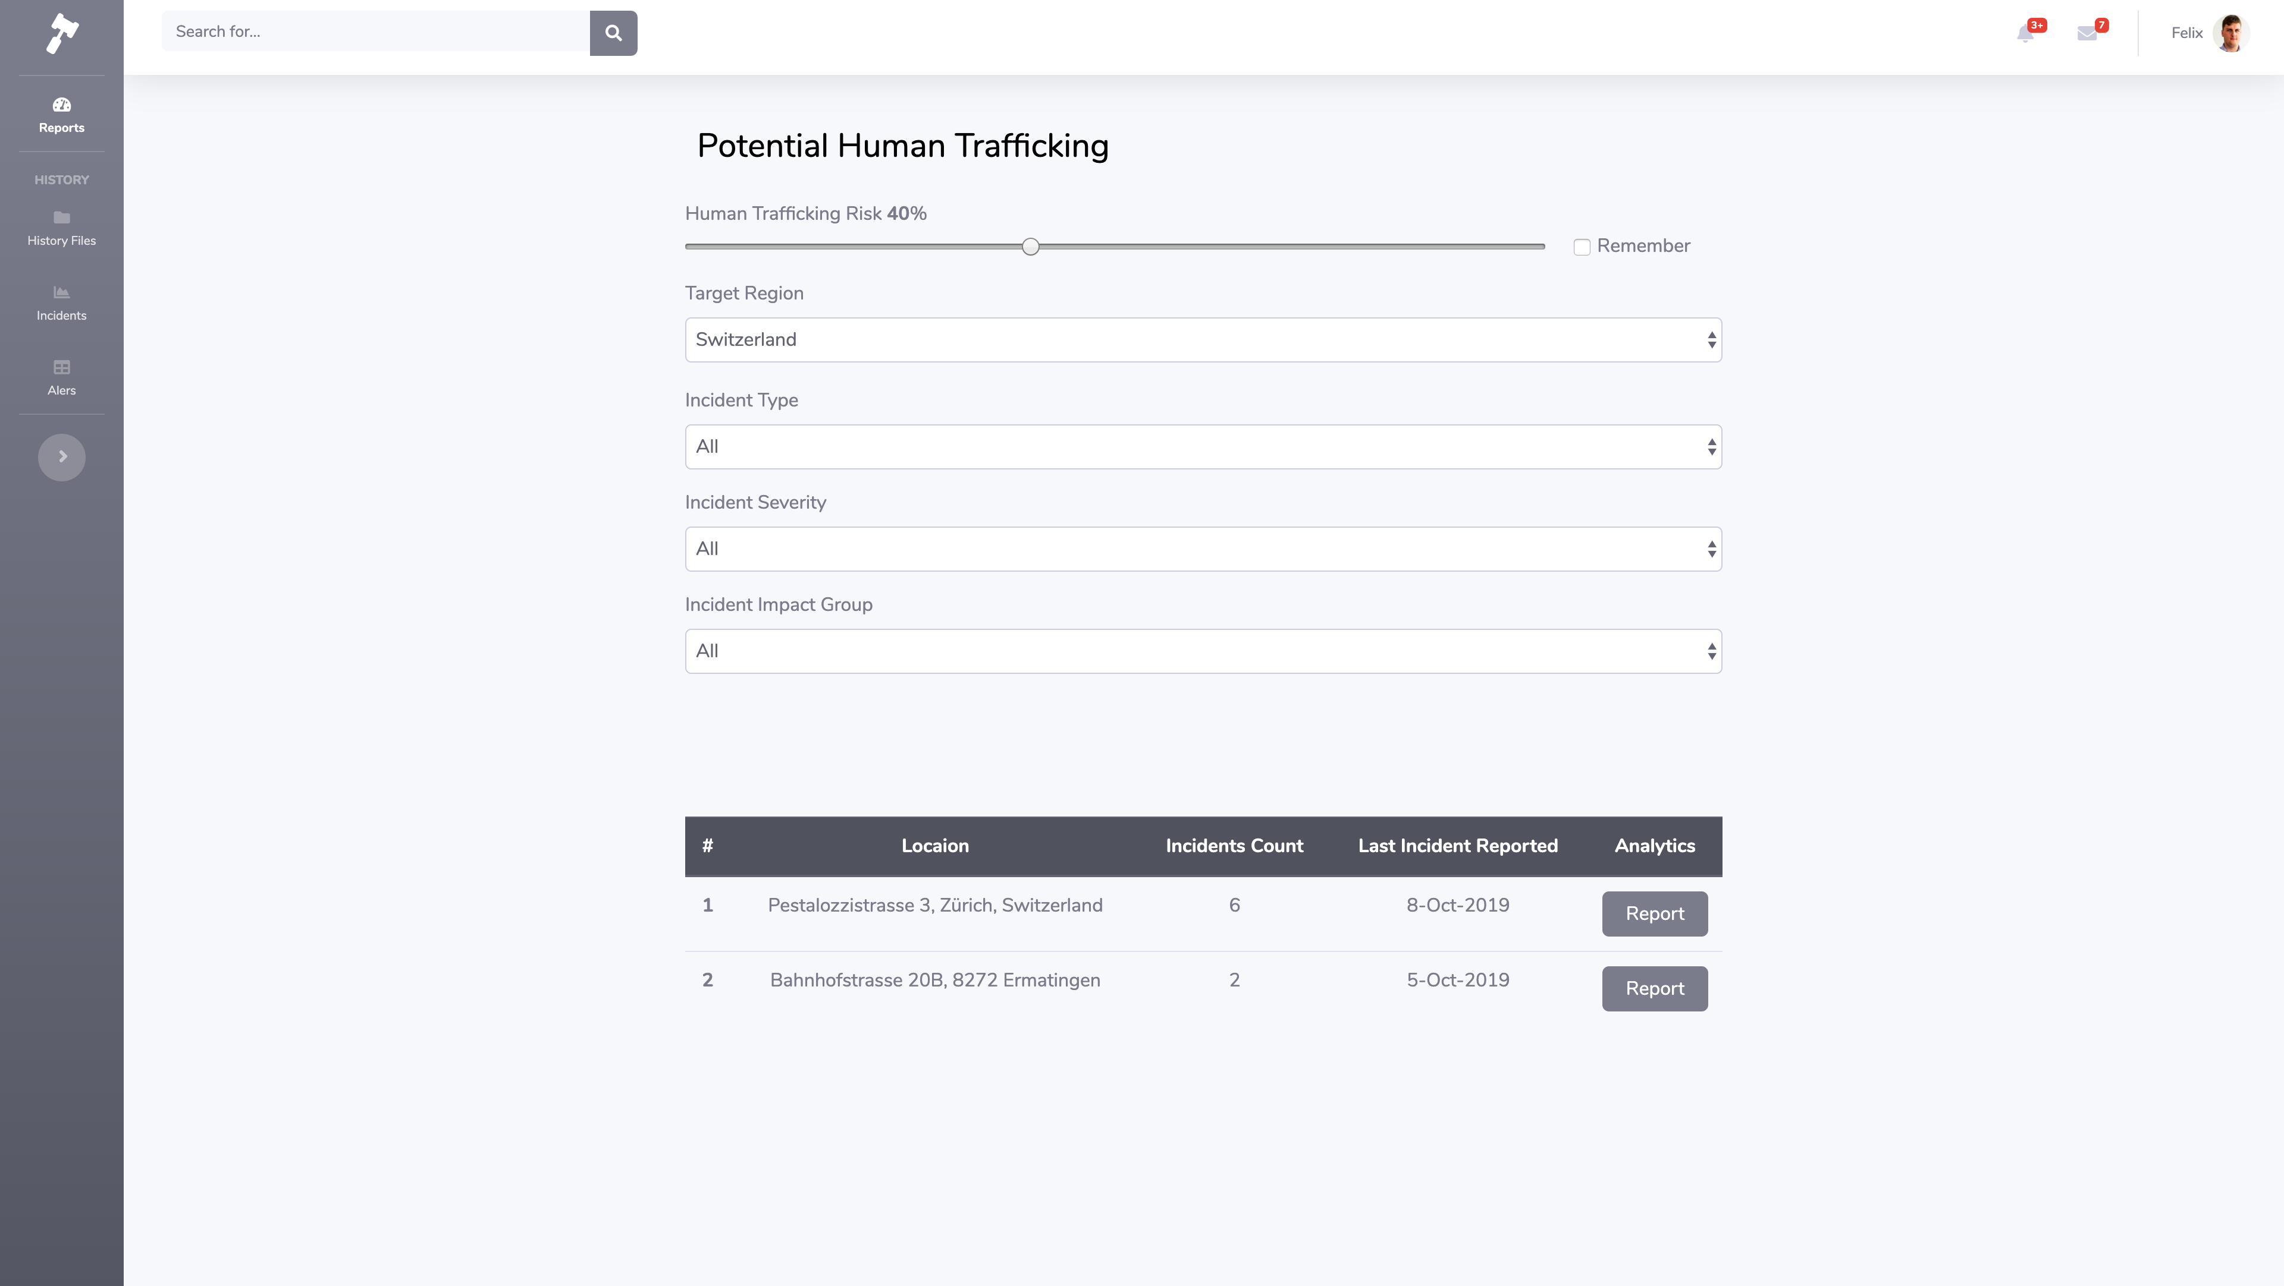
HUMAN TRAFFICKING AND RELATED ACCOUNTING TRANSACTIONS REPORTING

Slide 10
HAT - R
HUMAN TRAFFICKING AND RELATED ACCOUNTING TRANSACTIONS REPORTING
ID of Flagged Entries
XG Boost Forest
Accuracy: 98%
TP: 80%

Slide 11
HAT - R
HUMAN TRAFFICKING AND RELATED ACCOUNTING TRANSACTIONS REPORTING
Confirmation of
HAT - Spots

Slide 12
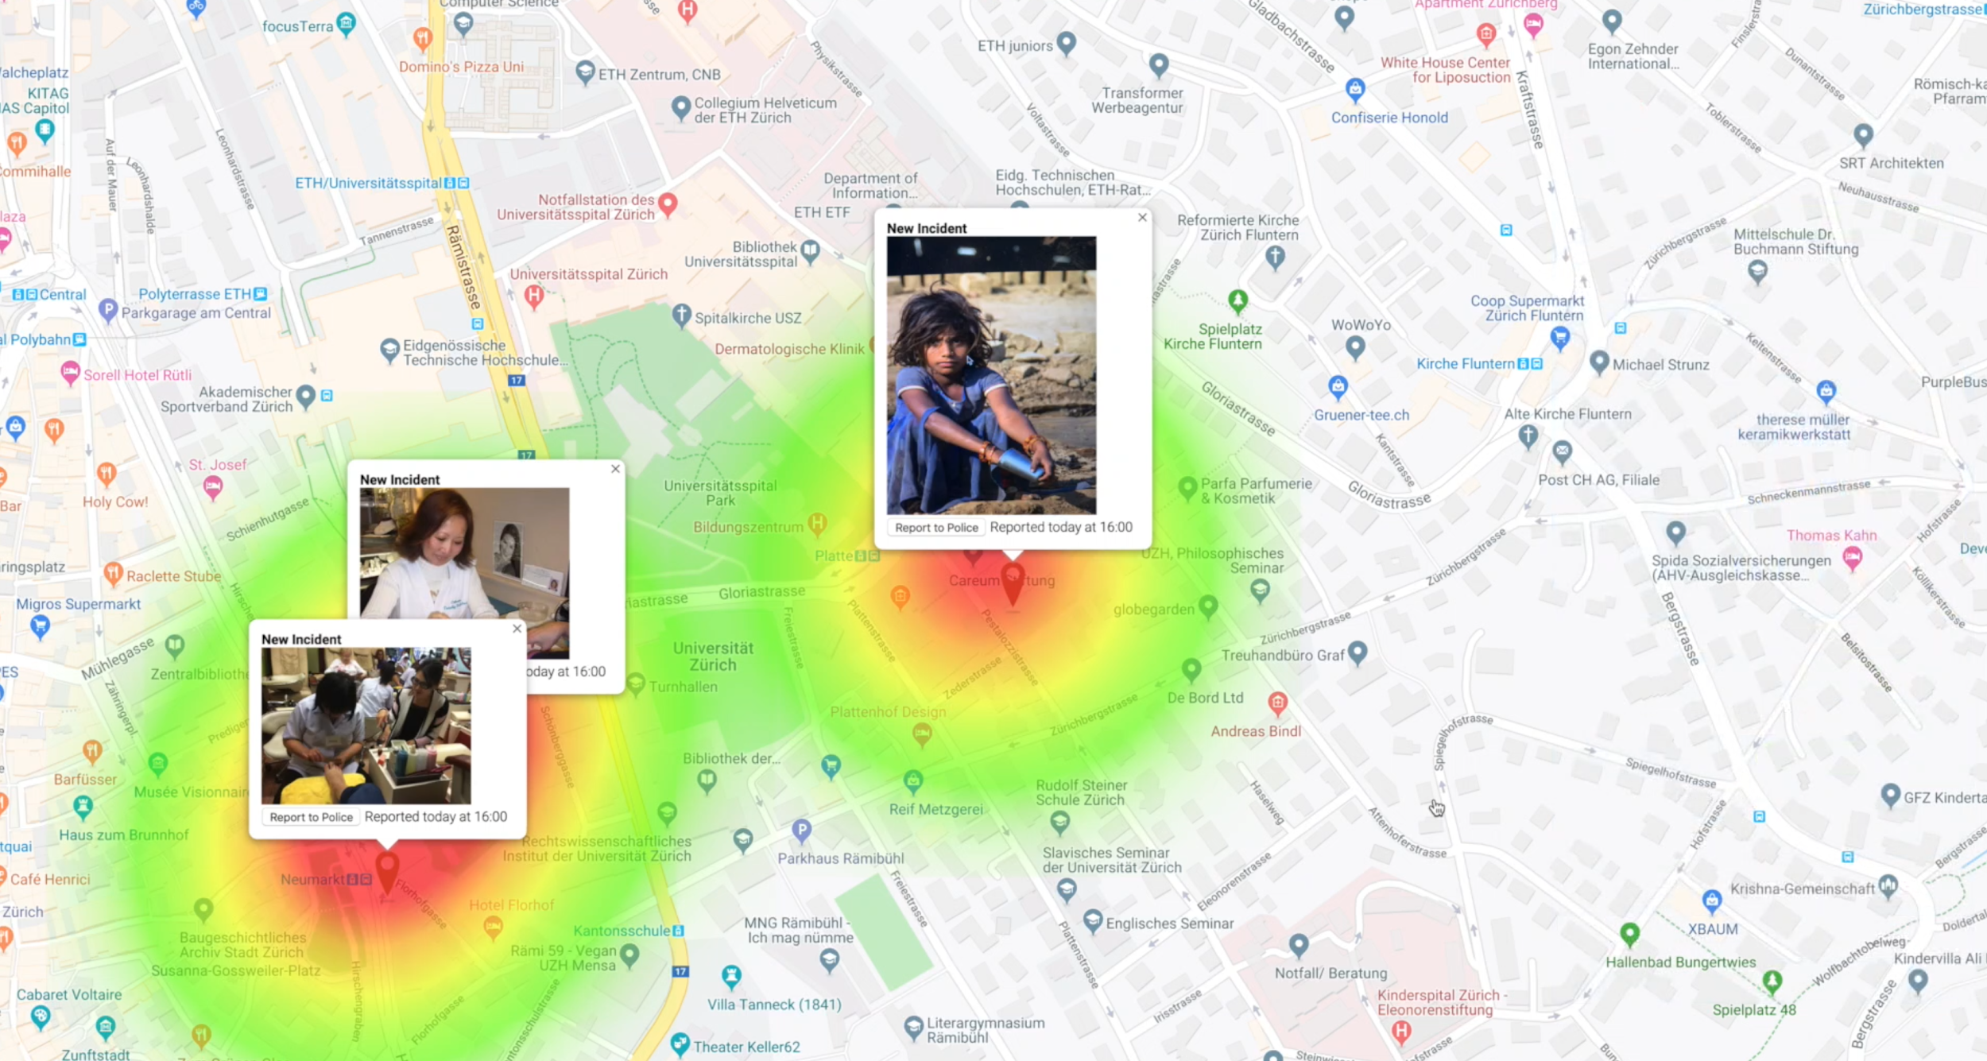
HUMAN TRAFFICKING AND RELATED ACCOUNTING TRANSACTIONS REPORTING

Slide 13
HAT - R
HUMAN TRAFFICKING AND RELATED ACCOUNTING TRANSACTIONS REPORTING
Support of HAT - Spots
Azure Bot Framework
Azure Computer Vision
Support of HAT - Spots
NLP Azure Cognitive Services
Google Maps API
ID of Flagged Entries
XG Boost Forest
Accuracy: 98%
TP: 80%
Confirmation of
HAT - Spots

Slide 14

PINPOINT - HAT
“Putting illicit banking activities related to human rights violations & trafficking on the map.”

